Slide 1
A Guided Tour of LINCS for the Detroit Adult Foundational Skills Learning Community
Welcome
Notes:
Judy will start the session, say hello and turn it over to Sydney to give an introduction to the platform [CHAT feature, microphone auto muted, etc]
Sr. Janice Reading Works will welcome everyone
A Guided Tour of the LINCS Adult Education Professional Development Online Tool
This webinar is part of the series of monthly workshops provided by Reading Works, in partnership with CSW, the DRWF, DESC, the City of Detroit, and JPMorgan Chase. LINCS is the online Literacy Information and Communication System providing high-quality, on-demand educational opportunities for those in the field of adult education. It includes a resource center, online courses, and communities of practice for practitioners and administrators; a learner center of free online resources for students; and resources and services for state staff. Your tour guides will be Judy Mortrude of World Education and Jesse Stadd from the Manhattan Strategy Group (MSG), who manage the LINCS system for the US Department of Education. The theme of this tour is our four targeted program models – shown on next slide - and our tour guides will point out specific resources related to these topics.

Slide 2
Four Evidence-based Models in Detroit
Integrated Education & Training Programs
Foundational skill building is combined with occupational training and credentialing and tied to employment.
Career Pathway Bridge Programs
On-ramp foundational skills programs that connect to progressive levels of education, training, and employment to build careers and economic success over time.
Accelerated High School Diploma & Equivalency Programs
In-person, online or hybrid program models connected to occupational training and jobs, that results in individuals obtaining a diploma and in some cases employer-recognized credential.
Employment-Based Programs
Foundational skills programs, including HS diploma/equivalent, connected to employment. Employers support program with space, time-off, worker pay.
Notes:
Speaker: Sr. Janice. Review the four strategies.

Slide 3
Improving Access to High-Quality Teaching and Professional Development Resources for Adult Educators
August 21, 2019
Notes:
Speaker: Judy
We are so happy to join your learning community today!
Today’s session will provide an overview of LINCS and the many freely-available, high-quality resources that are available on it. We want to start today by learning a bit more about you and how or if you’re already learning LINCS.
In this ZOOM format, you’re muted but you have the ability to communicate via the CHAT box. If you could find the CHAT box and try it out – type your name and your organization and maybe something about Detroit for us. Your advice for us when visiting Detroit – what must we see or do in Detroit in the summertime?

Slide 4
Disclaimer
This presentation was produced and funded in whole with Federal funds from the U.S. Department of Education under contract number ED-ESE-15-A-0012/0003 with Manhattan Strategy Group. Monique Faulkner served as the Contracting Officer’s Representative. The content of this presentation does not necessarily reflect the views or policies of the U.S. Department of Education nor does the mention of trade names, commercial products, or organizations imply endorsement by the U.S. Government.
Notes:
Judy: OK – one more thing before we get going - LINCS is operated by MSG under a contract with the US Department of Education, Office of Career Technical and Adult Education. This disclaimer let’s you know that although working under their contract, the content doesn’t necessarily reflect the views or policies of the US Department of Education.
OK! So now – a bit about your work!

Slide 5
What’s Your Role?
Type your job(s) into the CHAT box:
Teacher
Administrator
Business Service Specialist
Navigator
____?
Notes:
Judy: We’d like to get a sense of the work you do, the role you play in your organization. Again, if you could type in your role – is your job one listed here or something else – please share with us.

Slide 6
How Have You Used LINCS?
CHAT your experience:
I never have.
I lurk in the community.
I have searched the resource collection.
Notes:
Speaker: Judy
And, we’d love to learn a bit more about how you have used LINCS. IF you’ve used LINCS or if you’ve never heard of it before this webinar.
That was great. This gives us a good understanding of the level of use of LINCS, so that we can tailor our presentation today appropriately.

Slide 7
What is LINCS?
Notes:
Speaker: Judy
So, What is LINCS? LINCS is US Department of Education – Office of Career Technical and Adult Education (OCTAE) initiative to expand evidence-based practices in adult education through providing professional development and training opportunities to the adult education field. It is the federal support for the field of adult education.
LINCS is comprised of five components:
The community of practice;
The learning portal;
The resource collection;
The learner center; and
Resources for states, such as the LINCS Professional Development Center.

Slide 8
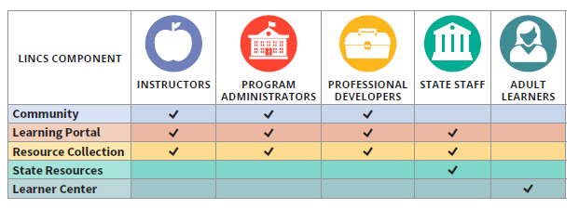
New Technical Assistance Resource: LINCS Quick Reference Guide
Where do I Start?
Notes:
Speaker: Judy
LINCS has a new Quick Reference Guide, designed to help users from five target audiences - teachers, administrators, PD specialists, state staff, and learning - identify which parts of LINCS may be most applicable to them. So essentially you have a 5x5 grid – the 5 LINCS components and the 5 target audiences. This document, available on the LINCS website also describes and recommends specific resources in each of the LINCS components for each audience.
I believe Sr Janice also sent you all a PDF version of this Quick Reference Guide earlier this week.
Please consider using the Quick Reference Guide to quickly see where instructors, program administrators, and professional developers can benefit from LINCS’ many evidence-based resources.

Slide 9
LINCS for Teachers and Providers
Notes:
Speaker: Jessie
Let’s dive deeper into the LINCS components that have many resources targeted to teachers: the community, the resource collection, and the learning portal.

Slide 10
What is the LINCS Community?
13,000+ registered members
11 topical groups
Dedicated subject matter expert moderators
Notes:
Speaker: Jessie
The LINCS Community is a virtual professional learning space for adult educators and stakeholders. The community has over 13,000 members from across the nation. Members join topical groups to engage in discussions focused on critical topics to the field of adult education. Groups are supported by moderators who facilitate conversation, share relevant resources, and coordinate special episodic events such as guest discussions or expert-led webinars.
[MOVE TO WEBSITE]
On the front page you’ll see all new announcements, resources, and activities in the LINCS community.
The community is separated into public and micro-groups (micro-groups have a very specific focus). You are welcome to join as many groups of interest and participate in the community as you would like. On the groups page you are able to see how many posts are within the community group as well as the date of last activity. You can also look at which groups have recent activity.
When you click on a specific group you will be able to see a number of features:
An overview of the group which describes the target audience and the topics which may be discussed in the group
A discussion board
Documents with helpful information that were posted by the moderator
Moderator contact information
Recent members
The discussion board is where the majority of interactions occur. Members can post anything of interest within this board and obtain comments from the moderator and peers. Each of the discussion posts can also be tagged with keywords to make them easily searchable.

Slide 11
How do I use the community?
Ask questions
Read current and previous discussions
Search by keyword for specific information
Participate in community activities
Notes:
Jessie: So, as a recap, the COMMUNITY is the place to ask questions, join discussions or review discussions that have happened on topics you’re interested in, participate in community activities.
In your Detroit Learning Community Focus areas, you’ll find a great deal of information here on:
IET
CP Bridges
Accelerated HSE/D
Employment based programs

Slide 12
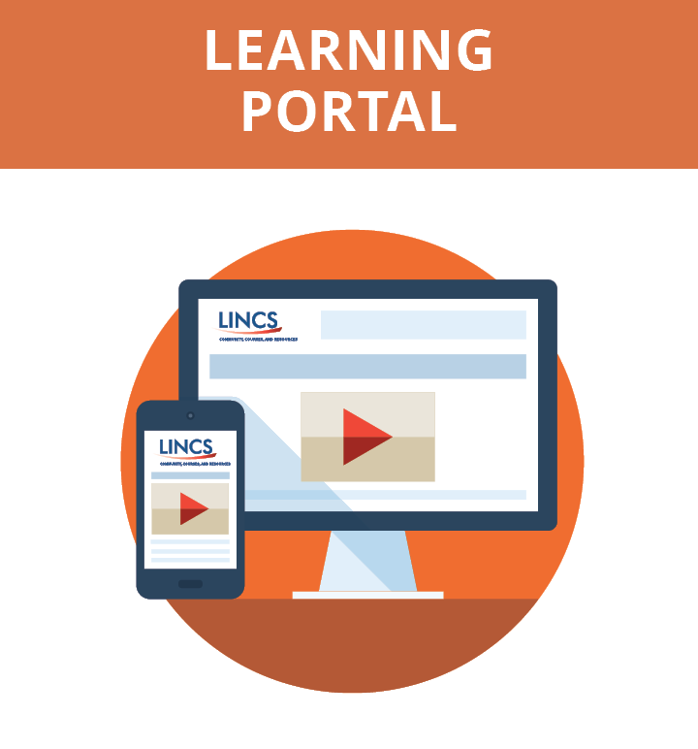
What is the Learning Portal?
Access to 20+ self-paced online courses that are always available
Download a certificate of completion for your records when you finish a course
Notes:
Speaker: Judy
The LINCS Learning Portal provides access to online courses for adult educators. Educators can explore 20+ self-paced, online courses available for use anytime, anywhere. Interested users can register for each course at any point, take as much time as needed to complete a course, and then download a certificate of completion for documentation when you are finished.
[GO TO WEBSITE - COURSES – CP – INTRODUCTION TO WFP and EMPLOYABILITY SKILLS]
Here’s a course that specifically introduces the Employability Skills Framework from US ED. The audience for the course includes any of you on this webinar – teachers, administrators, advisors – The course is 1.5 hours and you can self-enroll. Once you do, you’ll receive an email and can access LINCS help if you need it.
If you’ve used this before, we’ve recently updated the look and functionality of the Learning Portal. So if you haven’t visited recently, stop by and take a look!

Slide 13
Courses Available
Career Pathways, including workforce preparation activities
Disabilities
English language acquisition
Integrating technology
Reading
Science
Teaching and Learning
Working with open education resources (OER)
Differentiated learning
Teacher effectiveness and teacher competencies
Instructional design
Motivating adult learners to persist
Notes:
Judy: The Learning Portal has courses in all of the topics you see here – and more are developed each year.
You can see that the FOCUS AREAS of your Detroit learning community dovetail nicely with some of the content on LINCS including all of the career pathway work, the teaching & learning differentiated instruction courses, and the focus on integrating technology.

Slide 14
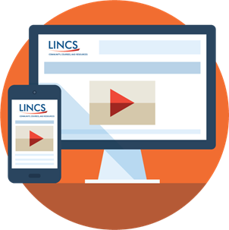
Updates!
Recently added:
The Dos and Don’ts of Teaching in Correctional and Reentry Education
Updated Learning to Achieve courses on Accommodations and English Language Learners
Courses coming this fall:
A Research-based Approach to Writing Instruction
Teaching Adults to Read
Notes:
Speaker: Judy
I want to note what is new and coming soon to the portal:
Some recently added courses:
The Dos and Don’ts of Teaching in Correctional and Reentry Education
Updated Learning to Achieve courses on Accommodations and English Language Learners
Courses coming this fall:
Writing
Teaching Adults to Read

Slide 15
What is the Resource Collection?
750+ vetted resources for various audiences, including many instructional and program management resources
Notes:
Jessie:
The resource collection includes more than 750 vetted resources for various audiences, including many instructional and program management resources.
[MOVE TO WEBSITE]
The LINCS Resource Collection (https://lincs.ed.gov/resource-collection) provides free online access to high-quality, evidence-based, vetted materials to help adult education practitioners and state and local staff improve programs, services, instruction, and teacher quality. Spanning 16 topic areas, the collection provides relevant instructional resources and professional development materials, as well as research articles, policy briefs, reports, multimedia resources, and more.
Again you can easily search by typing in keywords or phrases or by using the TOPIC AREA and RESOURCE TYPE filters.
[TYPE in Integrated Education & Training – review results]
[CLICK CP and VIDEOS – review results]

Slide 16
LINCS Components
The LINCS Community of Practice, the Learning Portal, and the Resource Collection are designed for adult educators.
Notes:
Judy: The LINCS Community of Practice, the Learning Portal, and the Resource Collection are all designed to support adult education instructors and their partners in adult career pathway delivery systems. But you don’t have to be a teacher to access and use these resources! Workforce development partners, human service partners, and other partners in your integrated education & training, career pathway bridge, and employment based initiatives may all find valuable resources here.

Slide 17
How LINCS Serves Adult Learners
LINCS Learner Center
Notes:
Judy: While LINCS primarily serves the adult educator community, LINCS also has resources for adult learners.

Slide 18
The Learner Center
The LINCS Learner Center connects students to free online resources which help them achieve their life goals.
http://learner.lincs.ed.gov
Notes:
Speaker: Judy
The LINCS Learner Center is the only website in the LINCS suite which is targeted to assist learners.
[MOVE TO WEBSITE learner.lincs.ed.gov]
On this site, learners can:
Learn to read
Learn math – the TV411 Math & Finance instructional videos
Learn science
Learn English – USA Learns & Share America – English Learning
Get job skills – My Next Move – Explore what you want to do for a living
Become a U.S. Citizen – Civics flash cards for the naturalization test
Find a program
Featured resources:
My Money.Gov: a website that describes the building blocks for managing your money.
Library for Adult Learners: has many resources to help individuals learn how to read
National Literacy Directory: directs adults to an adult education program based on their zip code provided
Question for participants:
IN WHAT WAYS DO YOU THINK THE LEARNER CENTER COULD BENEFIT YOUR STUDENTS OR PROGRAMS? [chat box]

Slide 19
How LINCS Serves States
LINCS PD Center
Notes:
Judy: We know that you are all regional Detroit professionals, but we also know that Michigan’s adult education system recently awarded a contract for professional development statewide system building, so we want to promote the free LINCS resources that can be interwoven with the state efforts to support scale and sustainability.
So I’ll take minute or two to share these LINCS services.

Slide 20
Why does LINCS provide services to states?
The LINCS Professional Development Center was established to assist states in meeting state leadership requirements set forth in WIOA Section 223 by:
Providing technical assistance (TA) opportunities for states to share promising models and resources, discuss challenges and solutions, and bolster their PD programs and training capacity
Delivering LINCS research-based, high-quality trainings to states in-person and virtually (trainings are described in the LINCS Catalog – now online!)
Notes:
Speaker: Judy
LINCS provides technical assistance (TA) to state leaders and staff responsible for PD in order to meet WIOA Section 223 requirements. And in case you’re wondering, this section of WIOA describes the federal funds for state leadership activities – the 12.5% of the WIOA title II federal funds that come into Michigan that are designated specifically to support building the capacity of your adult education system.
The LINCS PD Center does this through dedicated TA activities and the delivery of evidence-based LINCS trainings, upon state request. In fact, this is such a training.

Slide 21
LINCS Services to States
Access to online tools to improve system-wide professional development planning and delivery
Request one of 150+ trainings to be delivered in a state by a LINCS national trainer
Work with the LINCS State Liaison for support in planning and leveraging LINCS resources in system-wide professional development efforts
Notes:
Speaker: Judy
LINCS provides specific services for the state audience, which I will just very quickly describe here.
[MOVE TO SITE - STATE RESOURCES, PDC, What’s new]
First, LINCS has a self-assessment and asset map tool that help states identify strengths and gaps in their professional development planning. In some states, VA for example, regions are using the self-assessment and asset map tool to support their professional learning conversations. Your Detroit learning community could certainly do that.
States use these tools – and customize these tools - to identify areas where a LINCS training could help fit a need. Then States can request LINCS to deliver one of our 150+ trainings in a state. LINCS trainings are delivered by national experts in the topic. We have a cadre of trainers from across the country who share their expertise.
LINCS also has a dedicated staff member to build partnerships between LINCS and staff, serve as a point of contact, and assist them in leveraging LINCS resources in their PD planning.
There’s also a link here to archived information on the many federally supported adult education initiatives:
[SHOW FEDERAL INITIATIVE – click on ADULT CP TRAINING – click on WEBCAST of Developing Effective Bridge Programs]

Slide 22
LINCS Services to States, cont.
Receive support migrating LINCS courses to a state platform
Participate in webinars, collaborative learning groups, and other technical assistance activities
Stay connected and informed through the PD Center’s distribution list
Contact the PD Center: pdcenter@lincs.ed.gov
Notes:
Speaker: Judy
States can also migrate LINCS courses to their own state learning management system.
The LINCS PD Center also has webinars and other activities - many of which are open to any interested individual.
You can find out about these activities through the PD Center distribution list to receive both our quarterly newsletter and any announcements.
To contact the helpdesk with any questions, including those related to course migrations, please contact pdcenter@lincs.ed.gov.

Slide 23
Ask a question or comment on LINCS.
Share with us a need – we’ll show you a LINCS resource to assist.
Notes:
Speaker: Jessie
So, now we’d like to spend some time in which you identify areas of need – and we’ll show you a LINCS resource that may be able to assist. We’ll go through how to find the resources that best meet your needs.
Please use the CHAT box to type in questions.
[MOVE TO WEBSITE to demonstrate]

Slide 24
Don’t Miss a Beat; Connect with LINCS
Join the Community: https://community.lincs.ed.gov
Access the Learning Portal: http://lincs.ed.gov/courses
Search the Resource Collection: http://lincs.ed.gov/collections
Explore the Learner Center: https://learner.lincs.ed.gov/
Follow the latest updates: @LINCS_ED
Join our professional group: LINCS_ED
Watch webinar archives and more: LincsEd
Notes:
Judy: So – we hope by now it’s clear that there are many ways to connect with LINCS. I’d love to know if any of you are currently engaged with LINCS.
So please use the CHAT and share how you might connect with LINCS:
Sign in to the community?
Post discussion threads or comments?
Participate in an online discussion?
Follow one of our social media accounts?
Participate in a LINCS study circle?
Share any LINCS content on their own social media account?
There are many ways you can tailor their own engagement with LINCS.

Slide 25
Advancing Innovation in Adult Education
Funded by the U.S. Department of Education's Office of Career, Technical, and Adult Education (OCTAE).
To identify, highlight, and disseminate innovative practices in adult education that lead to improved learner outcomes.
Application due September 30, 2019.
Learn more at https://lincs.ed.gov/state-resources/federal-initiatives/advancing-innovation
Notes:
Jessie: Before we wrap up, let me mention another OCTAE project supported by MSG: The Advancing Innovation in Adult Education.
This project will help spread the word about innovations in our field. Certainly the work happening in Detroit is something to share! Applications are due at the end of September and you can learn more at the link on this slide.

Slide 26
Contact
Jessie Stadd
LINCS Project Director
jstadd@manhattanstrategy.com
Judy Mortrude
LINCS PD Center Director
Judy_Mortrude@worlded.org
LINCS Website: http://lincs.ed.gov/
Notes:
Jessie: Thanks again for taking time to learn about LINCS. Here’s where you can find us and here again is the LINCS website – please visit!

Slide 27
LINCS Survey
http://www.surveygizmo.com/s3/2000536/LINCS-Customer-Satisfaction-Survey-One-Off
Please complete the LINCS survey via the link in the CHAT box.
Notes:
Sydney:
Before we turn this back to Sr Janice, we ask that you please complete the LINCS survey form.

Slide 28
Upcoming Workshops
September 26, 1-3 pm
Samaritan Center
Topic: Recruitment, Outreach, Student Motivation
October 17, 2-4 pm
Matrix Community Hall
Topic: Highlight Employer-Based Programs in the 10 pilots
November 15, all day
Wayne State University
PULSE Conference
December
Date and location TBD
Data-Driven Decision Making
Notes:
Sr. Janice review upcoming workshops.

